Slide 1

Student Academic Performance Prediction System
Using Study Hours, Attendance, and Learning Behavior Analysis
FINAL YEAR ENGINEERING PROJECT
MACHINE LEARNING · PREDICTIVE ANALYTICS
D.Selwa Raju
323129510060

Slide 2

The Problem with Traditional Evaluation
Conventional systems rely on retrospective grading, leaving institutions reactive rather than proactive.
Late Identification of At-Risk Students
Struggling students are flagged only after poor results — when intervention is least effective.
Siloed & Underutilized Data
Attendance, study hours, and behavior data exist separately and are rarely analyzed together.
No Predictive Intelligence
Without ML-driven forecasting, institutions cannot anticipate outcomes or personalize support.
Delayed Interventions
Manual processes slow response times, allowing academic decline to go unchecked.

Slide 3
Project Objectives
This system bridges the gap between raw institutional data and actionable academic intelligence.
1
2
Predict Academic Performance
Identify At-Risk Students Early
Apply ML models to study hours, attendance, and behavior for accurate performance forecasting.
Flag students showing early signs of academic difficulty before assessments occur.
3
4
Enable Personalized Guidance
Support Data-Driven Decisions
Generate individualized recommendations based on each student's learning patterns.
Equip faculty and administrators with dashboards and reports for timely intervention.

Slide 4
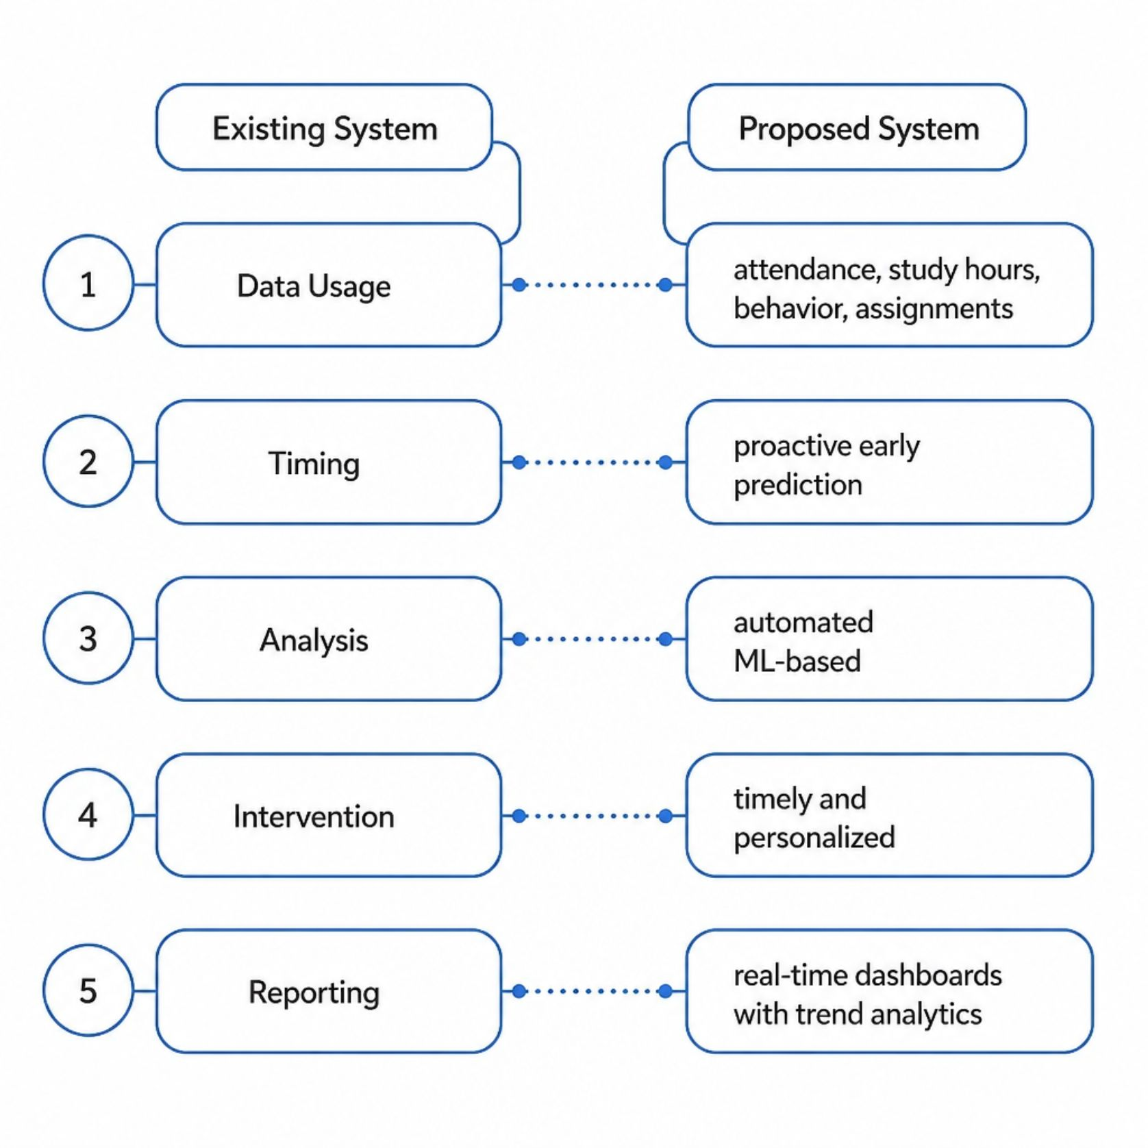
Existing System vs. Proposed Solution
A Paradigm Shift in Academic Monitoring
The proposed system replaces fragmented, manual evaluation with an integrated, ML-powered platform that continuously monitors, analyzes, and predicts student outcomes — enabling institutions to act before problems escalate.
The system is designed to be secure, scalable, and centralized — accessible to authorized faculty and administrators across departments.

Slide 5
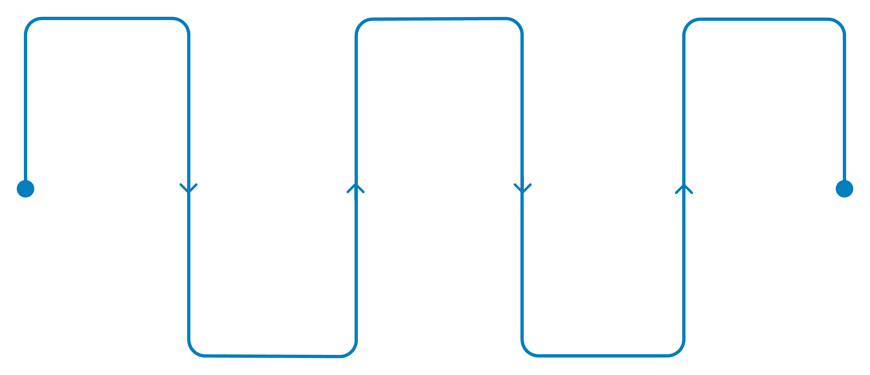
System Architecture & Overall Workflow
Data Collection
ML Model Training
Dashboard & Reports
Attendance, study hours, assessments
Classification and regression algorithms
Real-time alerts, trend charts, interventions
Data Preprocessing
Performance Prediction
Cleaning, normalization, feature selection
Risk scoring and outcome forecasts
The pipeline ingests data from LMS, attendance systems, and assessment platforms — processing it through preprocessing and ML layers before surfacing actionable insights on the monitoring dashboard.

Slide 6

Core Modules & Machine Learning Pipeline
Data Collection
Aggregates attendance, study hours, assignments, and assessment marks from multiple institutional sources.
Preprocessing & Feature Selection
Cleans data, handles missing values, and selects predictive features using correlation analysis.
ML Prediction Engine
Applies Random Forest, Decision Trees, and Logistic Regression to forecast performance and risk scores.
Risk Identification
Classifies students as Safe, At-Risk, or Critical — triggering automated alerts for faculty review.

Slide 7
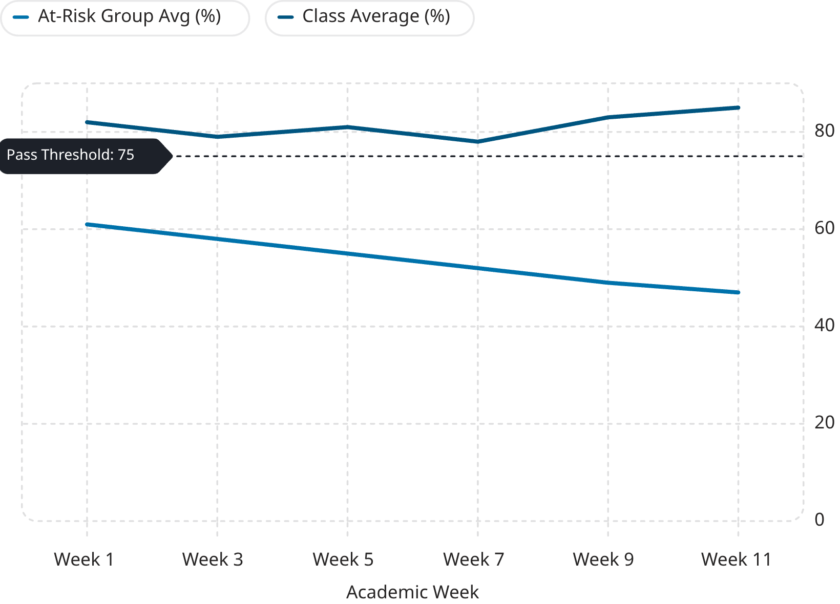
Performance Monitoring Dashboard & Analytics
Real-Time Institutional Intelligence
The dashboard provides faculty and administrators with a live view of class performance trends, individual student trajectories, and risk distributions — enabling timely, evidence-based interventions.
Student-level performance trend charts
Department-wide risk distribution summaries
Automated alert notifications for at-risk students
Exportable PDF and Excel performance reports

Slide 8
Technology Stack & Security Framework
Technology Stack
Security & Privacy
Role-based access control (RBAC) for students, faculty, and admins
End-to-end encryption for data in transit and at rest
FERPA and GDPR-compliant data handling policies
Audit logs for all system access and data modifications
Regular vulnerability scanning and penetration testing
Backend
Frontend
Python · Flask / Django · Scikit-learn · Pandas
React.js · Chart.js · Bootstrap
Database
DevOps
MySQL · Redis (caching)
Docker · Git · AWS / Azure

Slide 9

Expected Outcomes & Advantages
30%
Earlier Intervention
At-risk students identified weeks before traditional methods would flag them.
85%
Prediction Accuracy
Expected model accuracy using ensemble ML techniques on validated datasets.
40%
Reduction in Failures
Projected decrease in student failure rates through proactive support.
24/7
Monitoring
Continuous automated tracking with instant alerts for faculty and counselors.

Slide 10
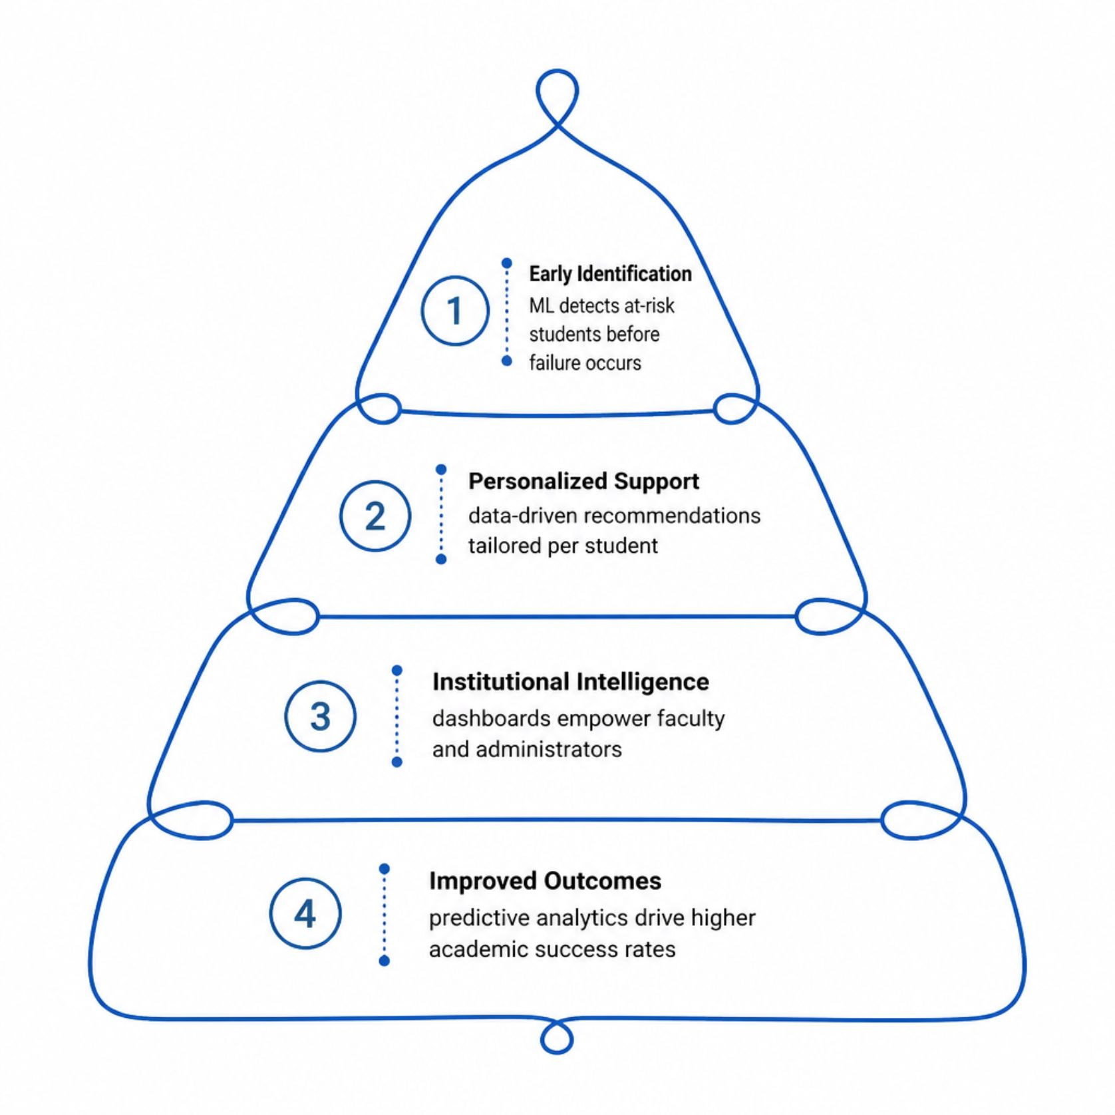
Challenges, Future Enhancements & Conclusion
Current Challenges
Data quality and consistency across departments
Model bias and fairness in predictions
Student privacy and ethical AI concerns
Integration with legacy institutional systems
Future Roadmap
Real-time learning behavior tracking via LMS APIs
Deep learning models (LSTM) for temporal patterns
Mobile app for student self-monitoring
Integration with counseling and support services
This system transforms academic monitoring from reactive grading to proactive, predictive student success — empowering institutions to act with confidence and care.

